Slide 1
云计算技术
陈果 副教授
湖南大学-信息科学与工程学院-计算机与科学系
邮箱：guochen@hnu.edu.cn
个人主页：1989chenguo.github.io
https://1989chenguo.github.io/Courses/CloudComputing2018Spring.html

Slide 2
What we have learned
What is cloud computing
Cloud Networking
Physical Structure
Applications and network traffic
Host networking virtualization
Addressing & Routing
Software-Defined Networking Architecture
Inter-data-center networking
Why multiple data centers
Traffic engineering for inter-data-center network

Slide 3
Content delivery networks
Part I: Cloud networking
Most materials from UIUC MOOC
Ankit Singla
ETH Zürich
P. Brighten Godfrey
UIUC
Credits to

Slide 4
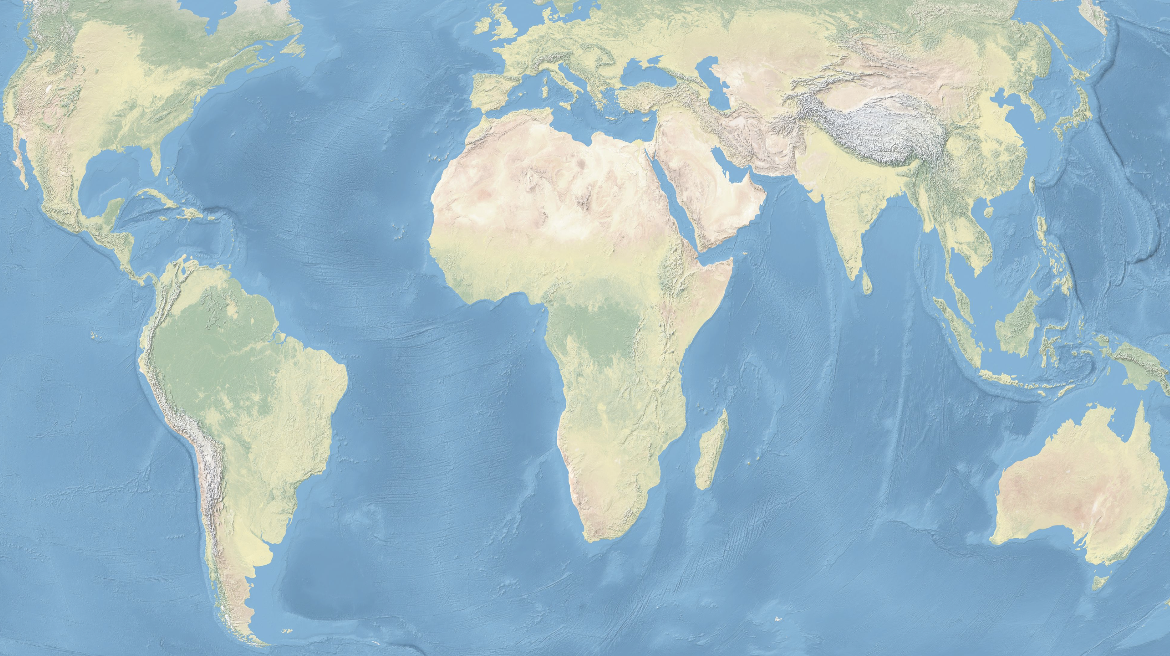
300ms
Map adapted from image by Ktrinko (Own work) [CC0], via Wikimedia Commons
Notes:
Let’s say you’re running a cloud service out of just one data center. This may be good enough for a small population of users located nearby. But what if clients all over the globe were to access this service? This approach provides no opportunity for load balancing, and tolerating failures at this site. Further, the far-away clients experience very high latencies. If a single network round-trip is 300ms, a rich service making a large number of round-trips will provide a poor user experience.
Public domain image: https://commons.wikimedia.org/wiki/File:Eckert4.jpg

Slide 5


Latency is money!
Latency
$$$$
+500ms lead to
a revenue decrease of 1.2%
+500ms in generating the search page => -20% in traffic
Notes:
Large latencies are known to impact user experience and hence, service-provider revenue. Google for example, has noted that an additional delay of 400ms on their search page load time translates to fewer searches by users. The 0.74% number may appear small, but in the absolute, this is a lot for a company like Google. Also, it reflects that users, consciously or sub-consciously, care about such small latencies.

Slide 6

Map adapted from image by Ktrinko (Own work) [CC0], via Wikimedia Commons
Notes:
Besides the latency aspect, providing service from one site can also mean moving huge volumes of data across the globe, particularly for applications like streaming movies. This can create huge demand for long-haul bandwidth, which is expensive.
Public domain image: https://commons.wikimedia.org/wiki/File:Eckert4.jpg

Slide 7

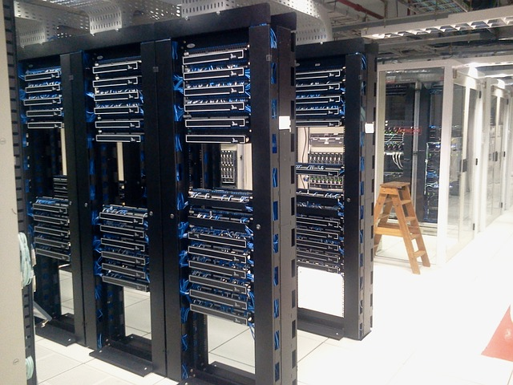
Why static caching is not enough
Client’s ISP
Other ISPs
Cache
Client
1
Volume and diversity of content
2
Dynamic content, encrypted content
Web service
Notes:
But doesn’t caching solve these problems? Let’s review how caching works. A client makes a service request. The response may be cached at a cache middle box that the ISP deploys. If another client requests the same data, and it’s present in the cache, this client can simply get the data from the cache.
There are several reasons this approach does not go far enough. First, the volume and diversity of content, together with the long-tailed distribution of popular content, makes caching extremely difficult to benefit from beyond a certain point.
But even more crucially, significant amounts of content today are dynamic — either changing over time (like News), or personalized to users. The increasing trend of encryption also reduces the utility of caches — data encrypted with session keys specific to clients is not cacheable!

Slide 8
CDNs solve these problems
“Sixty-two percent of all Internet traffic will cross CDNs by 2019 globally, up from 39 percent in 2014.”
— Cisco
Notes:
CDNs address these problems …
… and as a result are on track to be carrying a majority of the Internet’s data soon.
So how do CDNs work? I’ll first provide a brief overview of the pieces that comprise the solution, and then delve into the details.

Slide 9
Map adapted from image by Ktrinko (Own work) [CC0], via Wikimedia Commons
1. Spread the content servers globally
Notes:
First, the content servers are spread over several locations. These servers can actually run a service, which means they can serve dynamic data over encrypted connections, unlike a cache which is limited to serving static content.

Slide 10
Map adapted from image by Ktrinko (Own work) [CC0], via Wikimedia Commons
2. Network the sites and the origin
Notes:
Second, the content or service needs to be replicated at these locations. Data needs to be kept fresh, and the service provider may want to gather analytics. Further, client interactions may require fetching data from either other CDN nodes or the service provider’s origin servers. All this requires high capacity networking between the CDN nodes and the origin.
One may simply use standard Internet transit through an ISP, or private connectivity over fiber that one leases or owns. Some of what we discussed in our discussion of WAN connectivity applies here, but we’ll also discuss more latency-focused techniques later in this lesson.

Slide 11
Map adapted from image by Ktrinko (Own work) [CC0], via Wikimedia Commons
3. Direct clients to appropriate servers
Notes:
Lastly, once the service is replicated, how do clients learn where to get the content from? Some mechanism is needed to direct clients to an appropriate server — based on metrics like latency in order to improve performance for clients, or the load at different locations to improve load balancing across the CDN’s infrastructure.
It’s worth mentioning that while large operators like Google may build and operate their own CDN infrastructure, most Web services use one or more of the big CDN providers like Akamai, Limelight, Level-3, etc.
Let’s look at each of these three aspects in more depth.

Slide 12
Map adapted from image by Ktrinko (Own work) [CC0], via Wikimedia Commons
1. Spread the content servers globally
Notes:
Where does one put the content servers? The placement decision is not necessarily about geographic distance, but about network distance! Which is partly why colocation facilities and Internet exchange points are great choices. An Internet exchange point or IXP is essentially a data center where ISPs connect with each other.

Slide 13
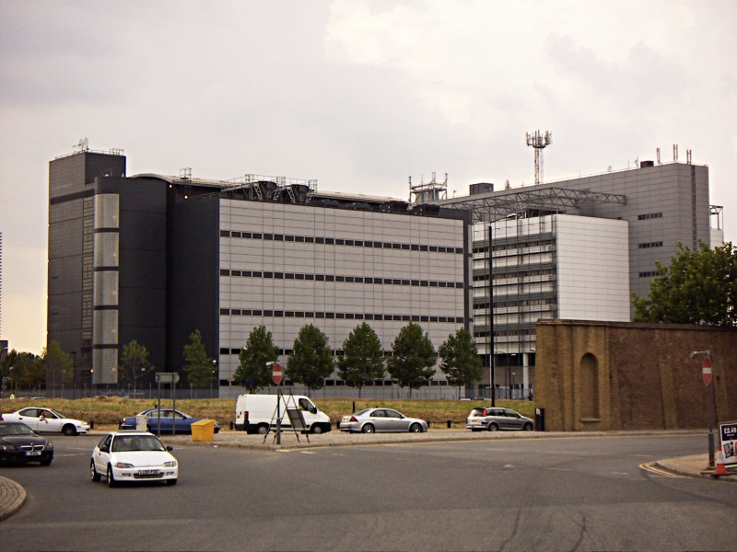
Image adapted from: “TelehouseDocklands”, John Arundel. CC BY-SA 3.0 via Wikipedia
Notes:
This, for example, is the London Internet Exchange. It’s one of the largest IXPs in the World. It’s much like the Heathrow airport of the Internet, moving around 2Tbps on average. Such facilities hold lots of network equipment …

Slide 14
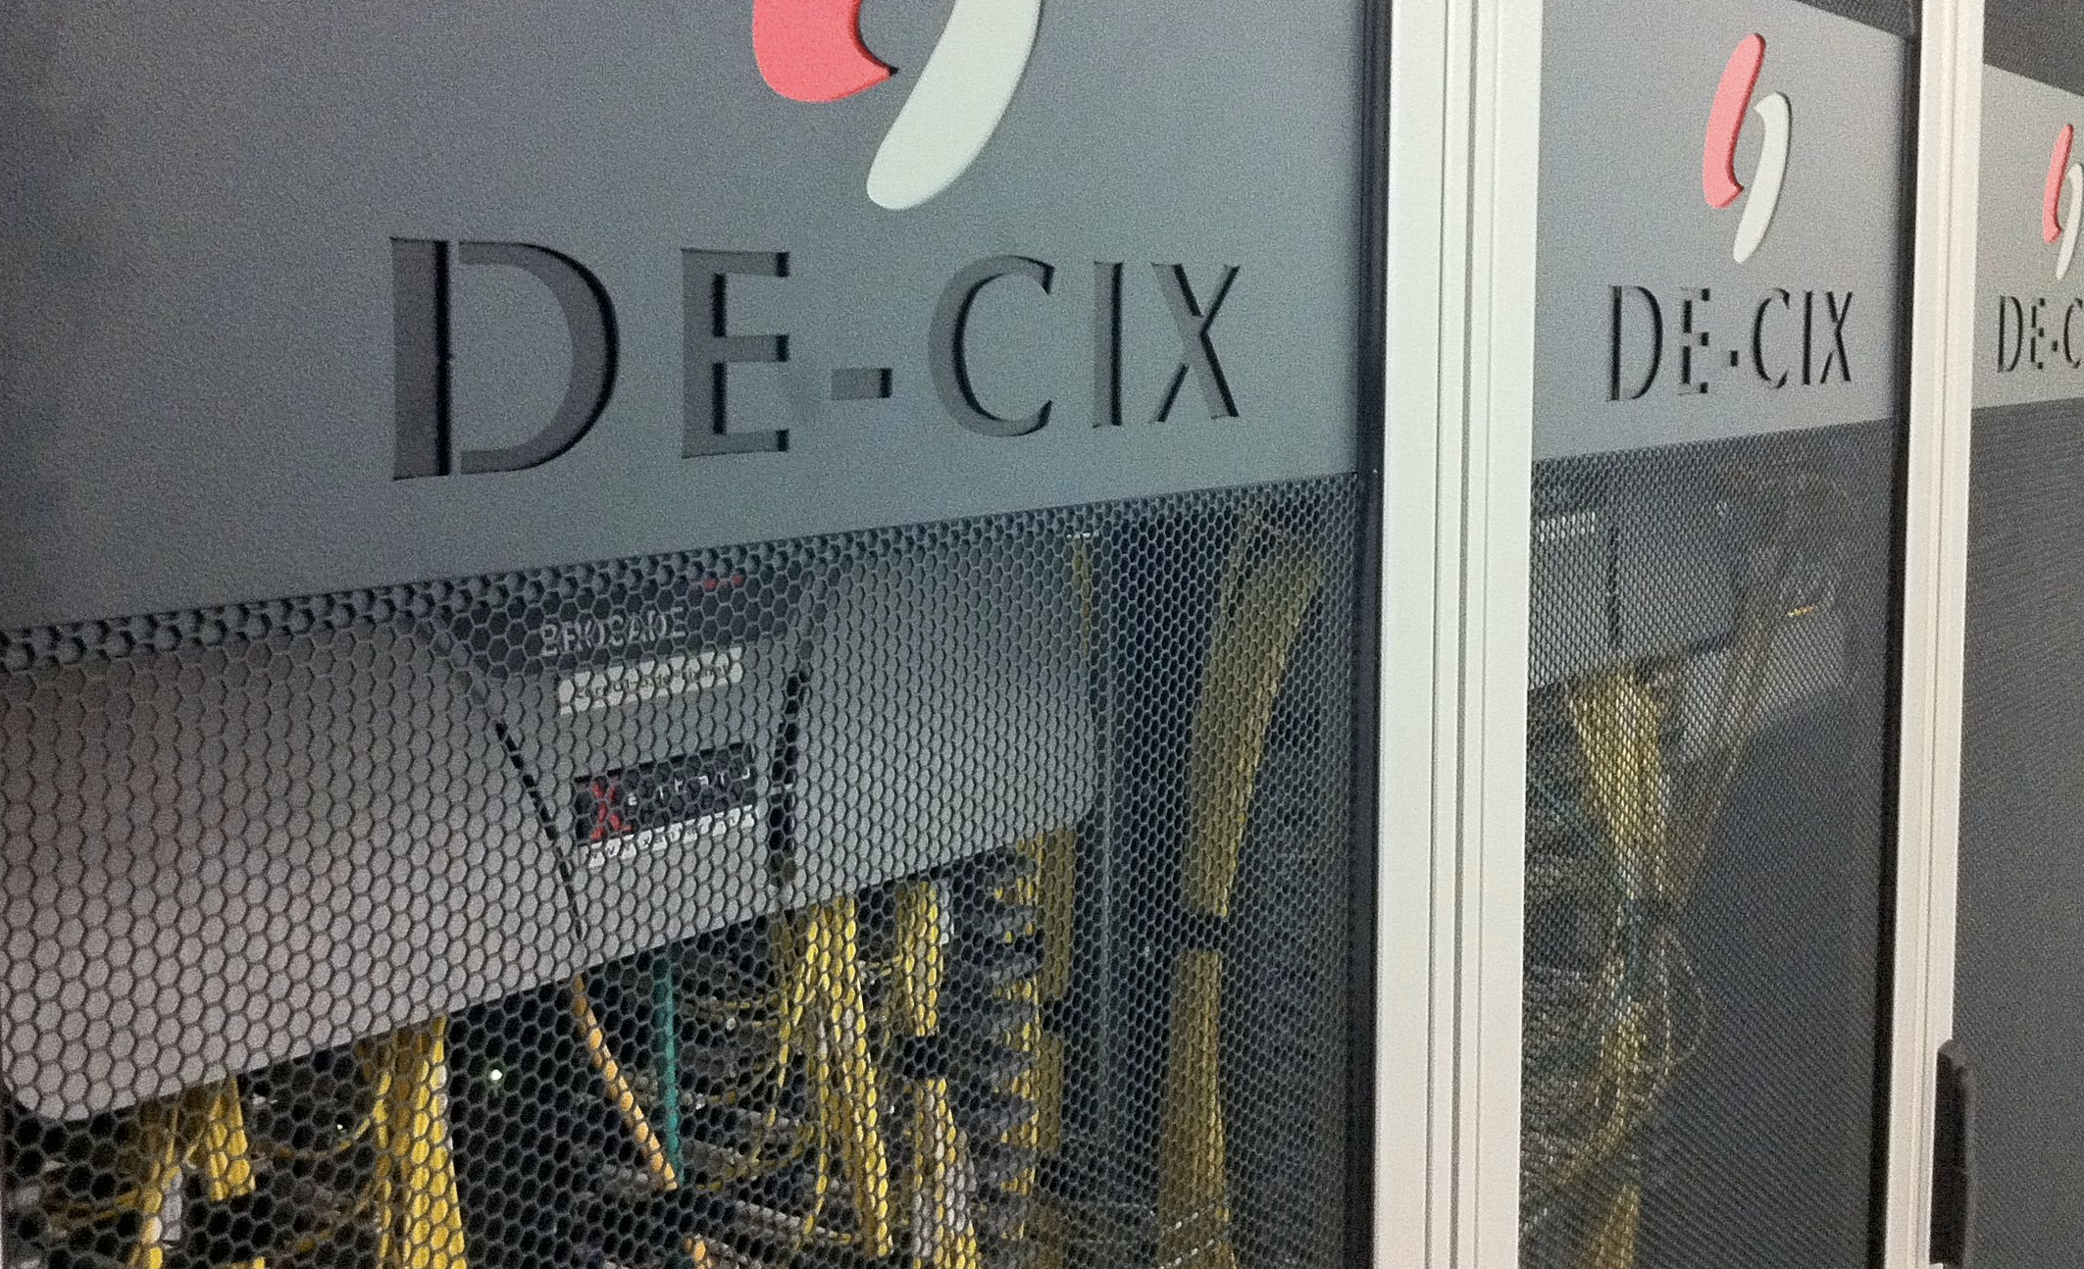
Adapted from image by Stefan Funke from Frankfurt, Germany (Switch Rack, Uploaded by MainFrame)
[CC BY-SA 2.0 (http://creativecommons.org/licenses/by-sa/2.0)], via Wikimedia Commons
Notes:
… like this. These are switch racks inside the world’s largest IXP (by traffic volume), located in Germany.
Housing your servers inside such a facility (if you can afford it, and server-space is available) or in a data center hosted by an ISP directly connected to it => good connectivity to everywhere.
But why would an ISP host CDN servers? For one, it means the ISP pays less in transit costs to its provider, carrying lesser traffic because the CDN servers serve a lot of content. Also, this improves the service for the ISP’s users, although at times, I have great difficulty believing this is a concern.

Slide 15


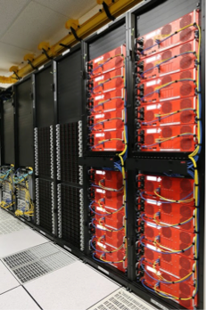
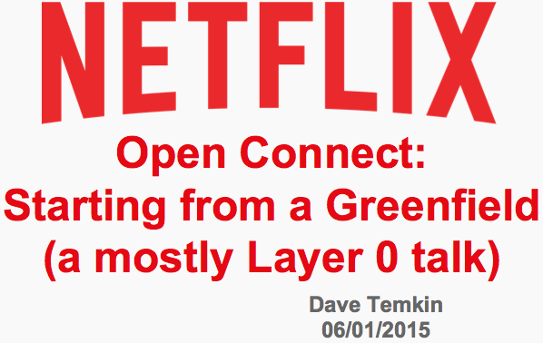

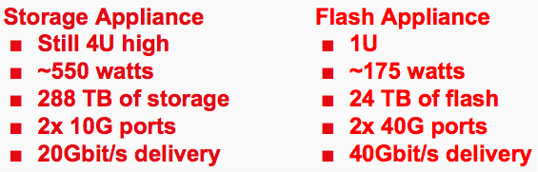
“more than 175,000 servers in over 100 countries and more than 1,300 networks around the world”
— Akamai
Notes:
Here you’re looking at one such CDN location. I pulled these images from a NANOG talk by Netflix’s Dave Temkin. (NANOG is a network operators group, which often gives a cool peek into network operations.) Netflix equipment is connected to tens of large facilities (including both the London and Frankfurt ones we just looked at), and the numbers will only increase as the service expands. These servers replicate Netflix content and stream video to the end users. Netflix uses custom-built boxes optimized to deliver video to clients at a small power and space footprint.
Different applications have different priorities. For Netflix’s video streams, 10s of locations with custom hardware work because latency is not the biggest determinant of performance for video streams (because of buffering). For latency sensitive Web applications, a larger number of locations with Web servers would work better. In fact, Akamai, claims to run …

Slide 16
Map adapted from image by Ktrinko (Own work) [CC0], via Wikimedia Commons
2. Network the sites and the origin
Notes:
As we noted earlier, CDNs move a lot of data around, and need to do it with small latency and high reliability. How does one network these locations? We already discussed briefly the physical interconnection aspects. But what I want to focus on here is the interesting opportunities for networking this setting provides at the routing and transport layers. At both layers, I’ll discuss one technique that’s in use in such networks today.

Slide 17
Getting your own way with routing
Notes:
Let’s start with routing …

Slide 18
Internet routing can be circuitous
a
b
Notes:
Unlike routing within data centers, Internet routing is driven by lots of independent players motivated by economics. This can lead to routes which are sub-optimal in terms of performance: an ISP might pick a next hop based not on which path has lower latency, but on which path is cheaper. Or sometimes, Internet routing can just suffer from configuration errors, and faults and anomalies which might take a while to be corrected.

Slide 19
Internet routing can be circuitous
1 140.109.17.1 1.857 ms 1.830 ms 1.819 ms
2 140.109.254.65 1.024 ms 0.964 ms 0.965 ms
3 140.109.254.29 1.702 ms 1.851 ms 2.036 ms
4 140.109.254.5 0.862 ms 0.895 ms 0.942 ms
5 202.169.174.1 1.320 ms 1.269 ms 1.433 ms
6 202.169.174.226 126.510 ms 126.498 ms 126.936 ms
7 4.59.4.1 276.592 ms 276.389 ms 276.527 ms
8 4.69.152.145 127.712 ms 127.741 ms 127.682 ms
9 4.53.210.110 128.843 ms 4.53.210.118 129.030 ms 4.53.210.114 128.602 ms
10 202.97.50.69 131.517 ms 131.466 ms 131.446 ms
11 202.97.50.117 305.707 ms 305.464 ms 305.652 ms
12 202.97.34.49 270.524 ms 270.410 ms 270.370 ms
13 202.97.50.225 306.119 ms 202.97.33.141 282.095 ms 202.97.50.241 277.718 ms
14 * * *
15 218.86.44.170 316.692 ms 316.784 ms 316.585 ms
16 218.6.10.242 291.273 ms 218.6.10.182 290.361 ms 218.6.10.166 297.248 ms
17 125.78.249.22 346.717 ms 218.6.10.138 296.387 ms 125.78.249.22 339.006 ms
18 125.78.249.22 335.653 ms 218.6.23.37 290.276 ms 290.287 ms
Taipei, Taiwan
a
b
San Jose, USA
500Km
(2.5ms)
Putian, China
Notes:
Here you’re seeing a real traceroute from Taipei to Putian in China (IPs obscured here, so you don’t hammer the same addresses with your probes.) The end-end latency here is 290ms, while the shortest distance round-trip on earth’s surface between these locations is around 500 Km, which would be just 2.5ms at speed of light in fiber. Sure, fiber isn’t laid along this shortest path, BUT that doesn’t explain a latency of 100x larger. Examining this trace revealed that this path runs through San Jose in the US! 21000 km.
Now, this instance is particularly extreme, and probably a transient anomaly, but Internet routes can be sub-optimal quite often. Situations of the type in this slide …

Slide 20

Internet routing can be circuitous
a
b
x
lab > lax + lxb
Notes:
… present themselves frequently. Here, the latencies are such that the direct route’s latency l_ab is larger than the sum of latencies over an indirect path through x: l_ax and l_xb. This is called a triangle inequality violation — if the Internet were doing shortest path routing, we would not see such situations, at least at times when the routes involved are stable. The name triangle inequality violation comes from the property of a triangle, where the sum of lengths of any two sides must exceed the length of the third side.
So how do we obtain more control over routes to avoid such situations?
Well, we can use overlay routing. If we have networked equipment inside these networks, we can simply have packets at a destined for b go to x, and for x to forward them onwards. At its simplest these could just be servers moving packets via tunneling as shown here.
Thus, even if the a-x-b path is not available over the Internet’s BGP routing, nothing stops us from doing at a higher layer!
Server image is pub domain: https://commons.wikimedia.org/wiki/File:Network-server.svg

Slide 21
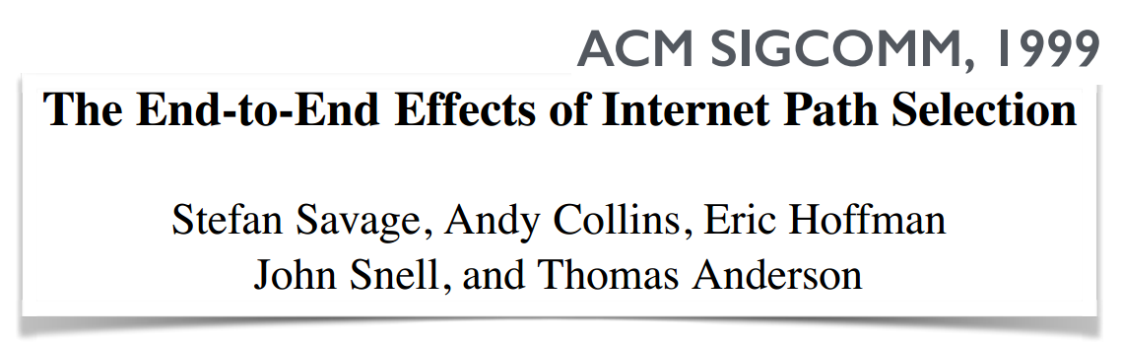
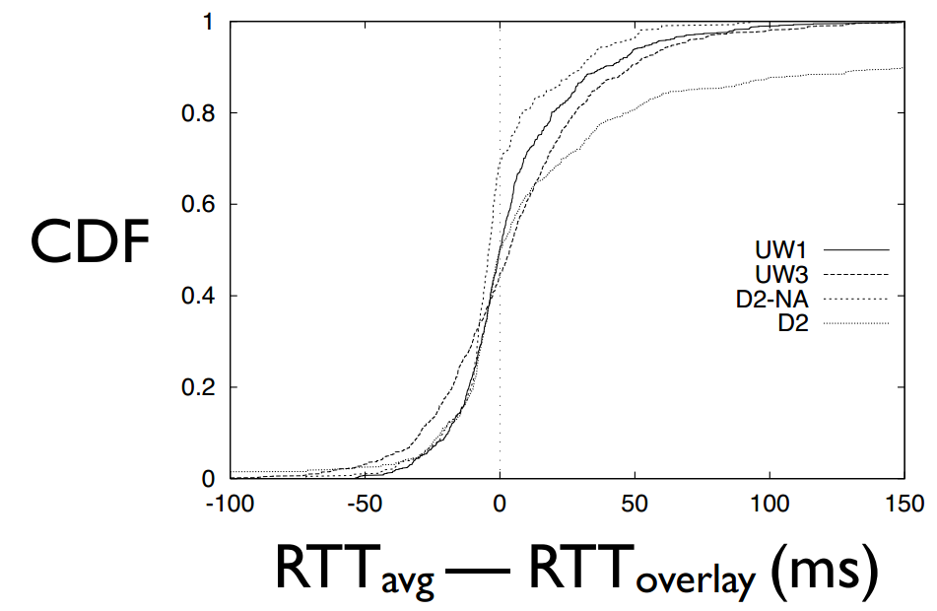
Overlay routing: lower latency, loss
Notes:
A 1999 study evaluated how much such routing could potentially improve latency. This is based on traceroute measurements between end-hosts. The measurements were collected over default routes on the Internet, and then compared against the best alternate routes they could stitch together passing through other end-hosts, in a manner similar to what I just described earlier. Now this dates back to 1999, and is biased towards university-based hosts and public traceroute servers, which may not quite be representative of typical end-host performance today. I wish there was newer and more extensive data available, but we’ll make do with this one — I wonder where we could get a large, representative sample.
For 30-55% of the host-pairs, routes with latency lower than the default path exist. In a significant fraction of these cases, improvements of more than 20ms!
The paper also includes similar analysis for loss rates.
While these measurements are old, this technique is used today in Akamai’s network.

Slide 22
Map adapted from image by Ktrinko (Own work) [CC0], via Wikimedia Commons
160ms
80ms
140ms
170ms
270ms
150ms
180ms
120ms
330ms
Monitor latency, loss on routes!
Notes:
Let’s review how one would make this work. We need active probing or passive monitoring of data traffic between the locations to keep track of the performance metrics. Let’s say this map shows the collected pairwise measurements. For scalability, if the network is large, one may not collect all pairwise measurements, but rather organize things hierarchically. One may also use passive measurement data — from logging the timing of regular data traffic.
With these pairwise measurements in hand, one can run a link-state protocol on top of this overlay, if one wishes to let individual sites make decisions. Or collect this information centrally and push out the overlay routes.
One point of note: there may be other considerations than lowest latency and loss, such as the cost of bandwidth.

Slide 23
Tweaking transport for speed
Notes:
Next, we’ll look at an improvement at the transport layer.

Slide 24
Map adapted from image by Ktrinko (Own work) [CC0], via Wikimedia Commons
SYN
400ms
SYN ACK
ACK
GET
400ms
Packets
ACK
Packets
400ms
…
…
Notes:
If a request requires making a connection to the origin server, or other CDN nodes, as is often the case, this can be quite inefficient: there’s the TCP handshake for setting up the connection, and then TCP slow-start to increase the rate, resulting in many round-trips, each of which can be quite long, as in this example.

Slide 25
Map adapted from image by Ktrinko (Own work) [CC0], via Wikimedia Commons
Even bigger advantage for SSL!
SYN
50ms
SYN ACK
GET
GET
Packets
400ms
ACK
Packets
Notes:
But CDN nodes can maintain persistent TCP connections to each other! In this scenario, the client still does the handshake, but only with the nearby CDN node, from where the CDN servers take over, using the persistent connection to simply send the request and get the response. Slow-start is also inessential between the CDN nodes because the connection is persistent and TCP has a large window size already. Of course, the client and the closest CDN nodes may still interact over several round-trips, but these are all smaller round-trips, 50ms in this example, as opposed to the 400ms to the origin.
This is an even bigger advantage for connections encrypted with SSL, which requires additional round trips.

Slide 26
Map adapted from image by Ktrinko (Own work) [CC0], via Wikimedia Commons
3. Direct clients to appropriate servers
Notes:
Lastly, let’s discuss how clients learn where to get the content from.

Slide 27
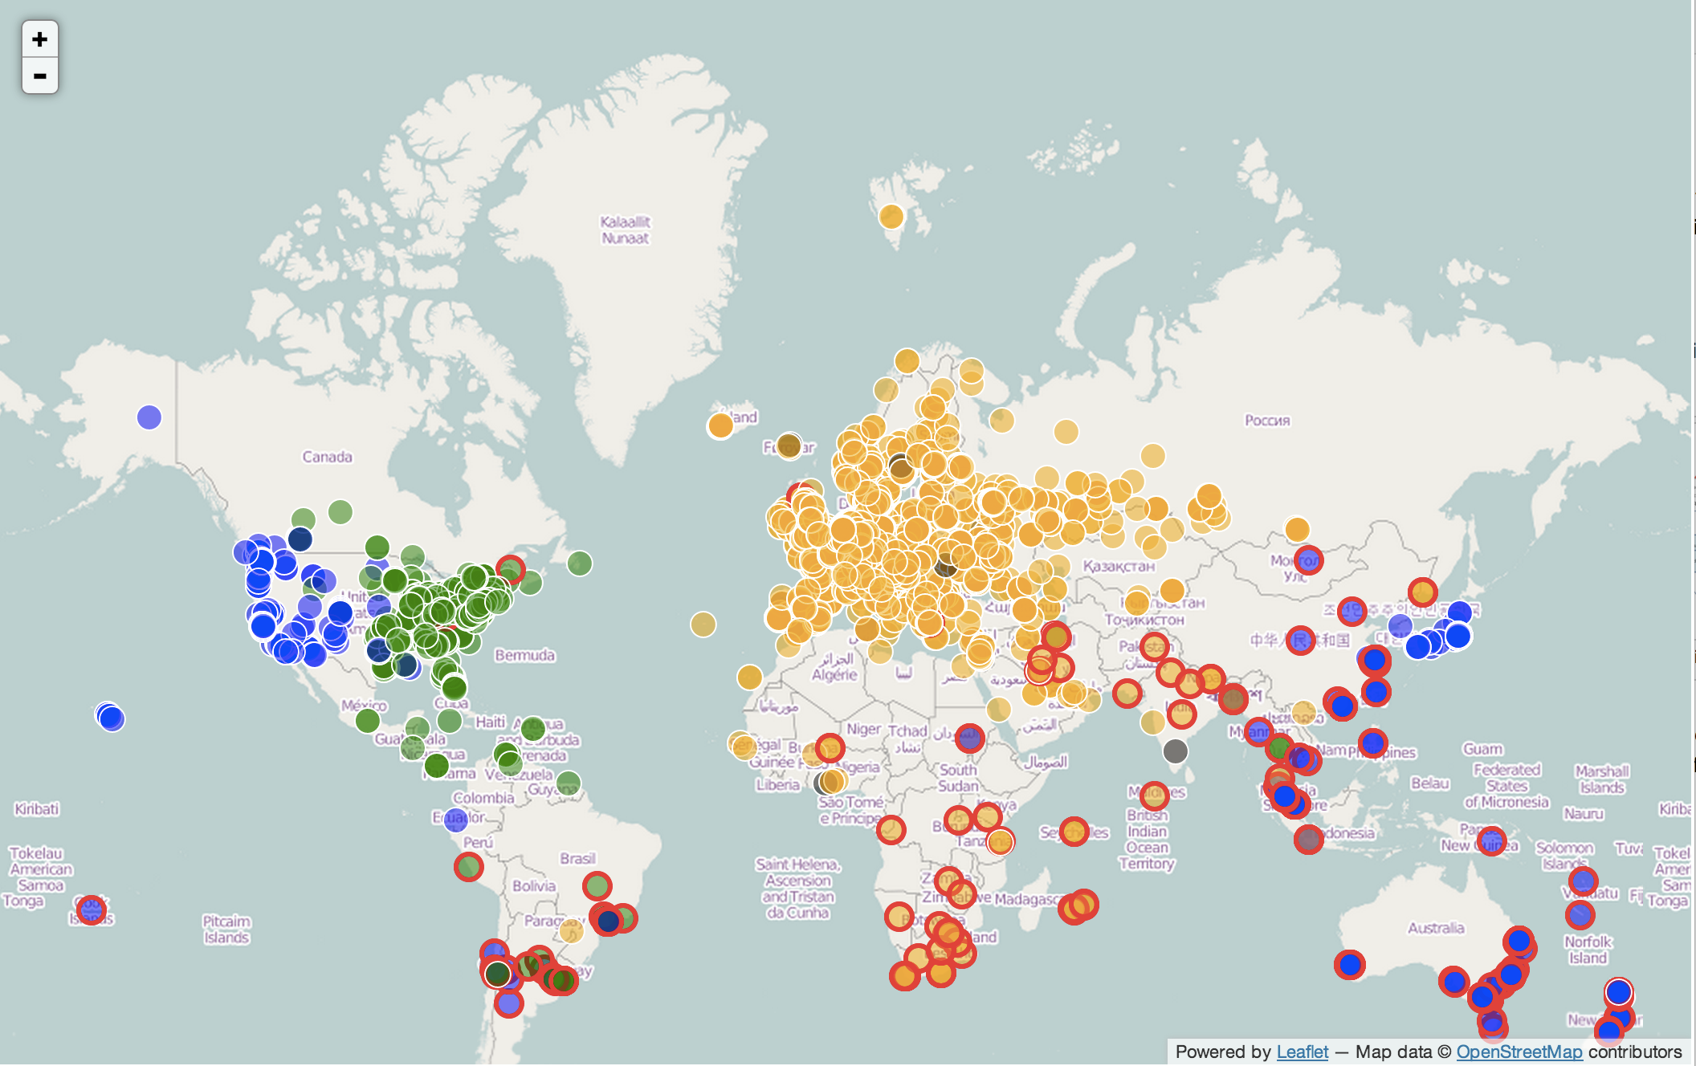
Adapted from image by Emile Aben [CC BY-SA 2.5 (http://creativecommons.org/licenses/by-sa/2.5)], via Wikimedia Commons
Notes:
Here is a map of latencies to Wikimedia’s 3 CDN locations, in Amsterdam, Ashburn and SF. Each bubble is a client measurement of latency. A bubble is colored …
Orange: the Amsterdam PoP has the lowest latency
Green: the Ashburn PoP has the lowest latency
Blue: the San Francisco PoP has the lowest latency.
Bubbles corresponding to clients with the lowest latency over 150ms have a red outline. Clearly, with all three locations quite far North of the equator, clients in SA, Aus, SE Asia suffer.
In terms of decisions about where to send which clients, what this map says is: with just these three locations, if you’re only optimizing for latency, … you want all the yellow colored locations to go to Amsterdam etc. etc. But there may be other concerns like load balancing and cost of bandwidth as well.
But this only settles the policy aspect. You monitor performance, and decide on which clients to send where. BUT how to enforce these choices?! Let’s see the mechanisms CDNs use to make this work.

Slide 28
URL rewriting
<html>
<img src=“http://www.abc.com/bigpicture.jpg”>
</html>
…
cdnurl.abc.com
…
Manipulate DNS for the rest
Notes:
First, the client gets the HTML for the landing page from the origin server. For a simple Web server, the resources will usually be served from the same domain in this example, the bigpitcture.jpg coming from abc.com. But for Web services using CDNs, instead of abc.com, the bigpicture.jpg may be served from cdnurl.abc.com.

Slide 29
DNS customized by location
TL resolver
Client’s ISP
cdn.abc.com ?
cdn.abc.com ?
x.cdn.net
x.cdn.net ?
l.m.n.o
CDN
resolver
Local DNS
resolver
CDN
cluster
GET …
DNS response depends on Local DNS resolver’s guessed location
Notes:
Next, the client’s browser will attempt to resolve cdn.abc.com. The client’s browser’s DNS request goes to their ISP’s DNS resolver, which further queries the top-level domain resolver. The TL resolver’s response is another domain name. This is called a CNAME i.e. a canonical name, or an alias. The local DNS resolver then reaches the CDN resolver to resolve this name. Now the CDN resolver can respond with an IP address for a CDN server close to the local DNS server. This decision may be based on IP geolocation.
It’s also possible that the CDN resolver further issues a CNAME response corresponding to a regional DNS resolver for the CDN etc. But the broad idea is to that the DNS resolution depends on the LDNS IP address, or rather its geolocation. And of course, the CDN resolver may consider other factors like load balancing in its name resolution. If the CDN site closest to the client is facing high load, it may direct it to the next closest site etc.
Finally, at the CDN’s cluster, a load balancer can send the client’s data request to the appropriate server.
The cluster name resolution has a short expiry in the LDNS cache.

Slide 30
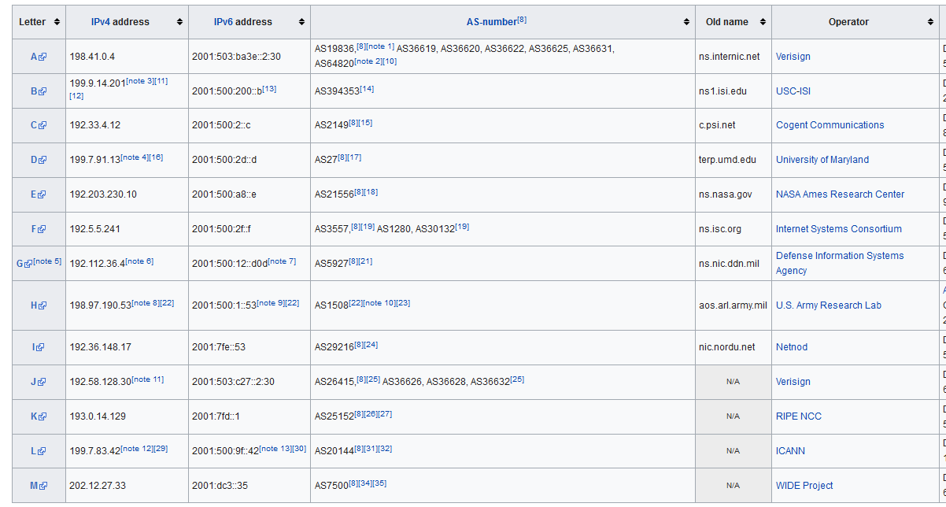
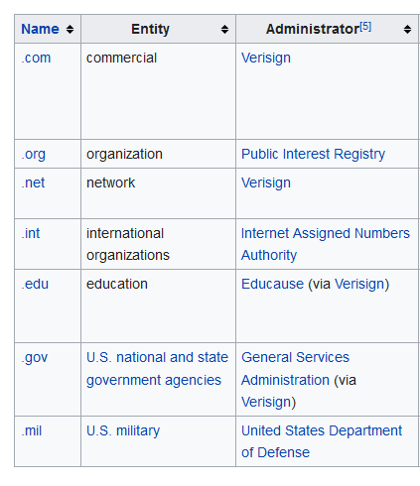
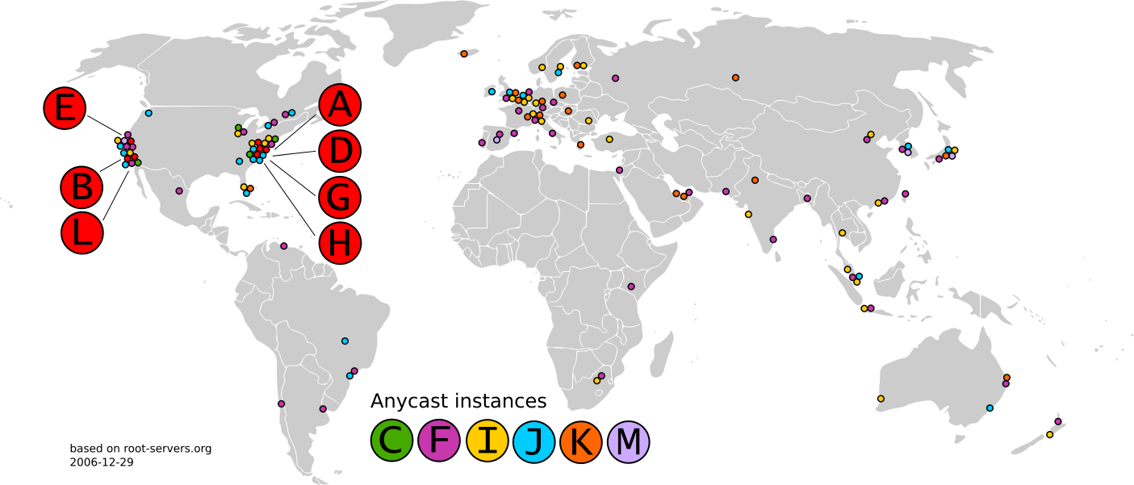
Root name servers
https://en.wikipedia.org/wiki/Root_name_server
Root name example

Slide 31
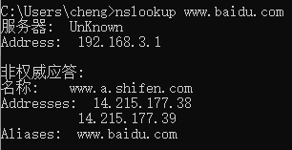
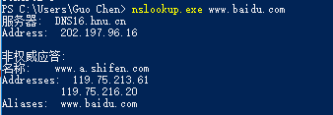
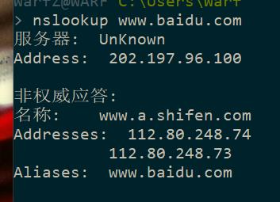
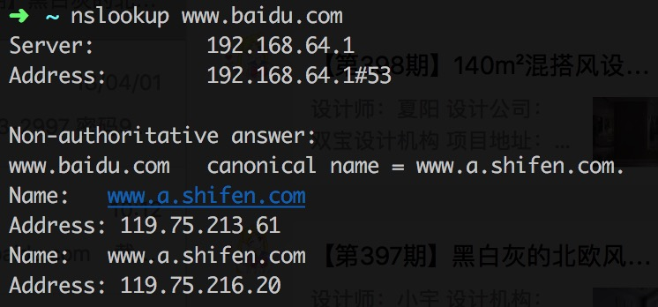
Example: DNS lookup for baidu
CSU, China Telecom
HNU, CERNET
TL resolver
Client’s ISP
cdn.abc.com ?
cdn.abc.com ?
x.cdn.net
x.cdn.net ?
HNU, CERNET, 8.8.8.8
Tsinghua, CERNET
l.m.n.o
CDN
resolver
Local DNS
resolver
CDN
cluster
GET …
DNS response depends on Local DNS resolver’s guessed location
Notes:
Next, the client’s browser will attempt to resolve cdn.abc.com. The client’s browser’s DNS request goes to their ISP’s DNS resolver, which further queries the top-level domain resolver. The TL resolver’s response is another domain name. This is called a CNAME i.e. a canonical name, or an alias. The local DNS resolver then reaches the CDN resolver to resolve this name. Now the CDN resolver can respond with an IP address for a CDN server close to the local DNS server. This decision may be based on IP geolocation.
It’s also possible that the CDN resolver further issues a CNAME response corresponding to a regional DNS resolver for the CDN etc. But the broad idea is to that the DNS resolution depends on the LDNS IP address, or rather its geolocation. And of course, the CDN resolver may consider other factors like load balancing in its name resolution. If the CDN site closest to the client is facing high load, it may direct it to the next closest site etc.
Finally, at the CDN’s cluster, a load balancer can send the client’s data request to the appropriate server.
The cluster name resolution has a short expiry in the LDNS cache.

Slide 32
DNS customized by location
TL resolver
Client’s ISP
cdn.abc.com ?
What if the client isn’t using the local DNS resolver?
cdn.abc.com ?
x.cdn.net
x.cdn.net ?
l.m.n.o
CDN
resolver
Local DNS
resolver
CDN
cluster
GET …
DNS response depends on Local DNS resolver’s guessed location
Notes:
Next, the client’s browser will attempt to resolve cdn.abc.com. The client’s browser’s DNS request goes to their ISP’s DNS resolver, which further queries the top-level domain resolver. The TL resolver’s response is another domain name. This is called a CNAME i.e. a canonical name, or an alias. The local DNS resolver then reaches the CDN resolver to resolve this name. Now the CDN resolver can respond with an IP address for a CDN server close to the local DNS server. This decision may be based on IP geolocation.
It’s also possible that the CDN resolver further issues a CNAME response corresponding to a regional DNS resolver for the CDN etc. But the broad idea is to that the DNS resolution depends on the LDNS IP address, or rather its geolocation. And of course, the CDN resolver may consider other factors like load balancing in its name resolution. If the CDN site closest to the client is facing high load, it may direct it to the next closest site etc.
Finally, at the CDN’s cluster, a load balancer can send the client’s data request to the appropriate server.
The cluster name resolution has a short expiry in the LDNS cache.

Slide 33



Anycast routing based approach
Adapted from http://stackoverflow.com/
Feel free to try this and discuss in the course forums! :)
Notes:
There is a completely different way of doing this as well, based on manipulating Internet routing, instead of domain name resolution. Just like this stack overflow query, you may also have wondered how some IP addresses, like Google’s 8.8.8.8 can be reached at low latencies from places that are far away from each other. For instance, the latency to this address may be 10ms from both Sydney, Australia and New York. (Feel free to try this and discuss in the course forums.) If this were one physical server, this would be impossible — those two locations would be 160ms apart even if a fiber line ran directly between them along the shortest path possible. The way this works is using anycast routing.

Slide 34
Anycast routing based approach
Announce the same BGP prefix from multiple locations
Client’s ISP
l.m.n.o
Other ISPs
Performance-based selection?
BGP route flaps?
l.m.n.o
Notes:
The key idea of anycast routing is to have different clients go to different physical servers which use the same address. How’s this accomplished? By announcing …
This avoids the problem the DNS-based approach runs into, i.e., guessing the client’s location. If the client is closer to one cluster, BGP routing will hopefully direct it to that cluster.
It does have its own drawbacks though: cannot adjust quickly based on load or observed performance, route-flaps can cause different packets to go to different places!

Slide 35
Thanks!
陈果 副教授
湖南大学-信息科学与工程学院-计算机与科学系
邮箱：guochen@hnu.edu.cn
个人主页：1989chenguo.github.io
https://1989chenguo.github.io/Courses/CloudComputing2018Spring.html

